Slide 1
DATA ACQUISITION • TIME-SERIES STRUCTURING • EXPLORATORY DATA ANALYSIS
Alexandria Weather
Time-Series Analysis
A NASA POWER-sourced daily record (2021–2025) explored for trend, seasonality,
and data quality ahead of forecasting work.
Alexandria, Egypt | 31.20°N, 29.92°E | 1,826 daily records

Slide 2
Objective & Scope
Retrieve an extended daily weather record for one region, structure it as a proper time series, and apply EDA techniques built for sequential data — not just summary statistics — to judge data quality and describe temporal behavior before any modeling.
1,826
7
0
5
daily records
variables tracked
missing values
years of history
2021 – 2025
temp, precip, humidity, wind, solar
or gaps in the date range
for trend & seasonality
WHAT THIS DECK COVERS
How the data was collected — API, parameters, and range
How it was cleaned and validated for time-series use
What the EDA reveals: trend, seasonality, stationarity, and anomalies
Alexandria Weather Time-Series Analysis
2

Slide 3
How the Data Was Collected
NASA POWER — Daily Point API
WHY THIS API & RANGE
ENDPOINT
No API key or throttling — one clean request returns the full multi-year record.
5-year daily window chosen (not a short hourly snapshot) to properly measure trend and seasonality.
Saved two ways: raw JSON (full fidelity) and a cleaned CSV with date, temperature, precipitation, +4 extras.
power.larc.nasa.gov/api/temporal/daily/point
REGION
Alexandria, Egypt — lat 31.2001, lon 29.9187
DATE RANGE
2021-01-01 to 2025-12-31 (5 years, daily)
PARAMETERS
T2M, T2M_MAX, T2M_MIN, PRECTOTCORR, RH2M, WS2M, ALLSKY_SFC_SW_DWN
AUTH / LIMITS
No API key required; no rate limits hit — single request, 200 OK
Alexandria Weather Time-Series Analysis
3

Slide 4
Preparing the Time Series
Before any analysis, the raw pull was validated as a proper time series: parsed datetime index, checked for gaps and duplicates, quantified missing data, and confirmed unit consistency.
Datetime index
Gap check
Duplicates
Date column parsed to datetime and set as the DataFrame index for time-aware operations.
Full date range compared against the index — 0 missing dates across all 1,826 days.
Index-level and row-level duplicate check — 0 duplicated timestamps found.
Missing values
Unit consistency
Result
0 nulls in every column — no imputation or interpolation was required.
Single-source pull: °C for temperature, mm/day for precipitation, %, m/s, kWh/m²/day — no conversion needed.
A clean, gap-free daily series — ready for descriptive, seasonal, and stationarity analysis.
Alexandria Weather Time-Series Analysis
4

Slide 5
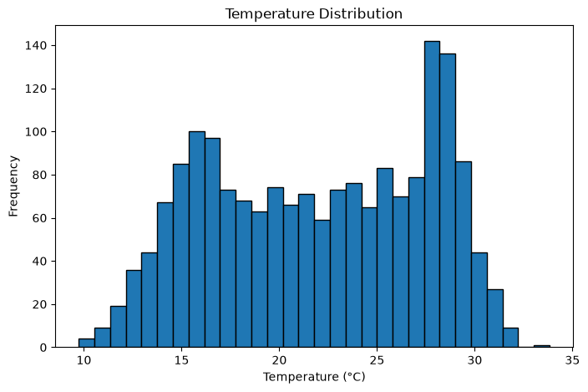
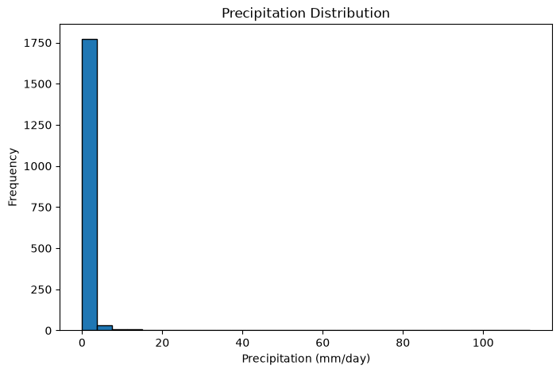
Q1
What does a typical day look like?
THE INSIGHT
Temperature is roughly bell-shaped: mean 22.0°C, range 9.7–33.8°C.
Precipitation is heavily right-skewed — most days are dry (median 0 mm), with rare spikes up to 111.6 mm.
Different shapes call for different tools: precipitation needs skew-aware methods like IQR, not z-scores.
Alexandria Weather Time-Series Analysis
5

Slide 6
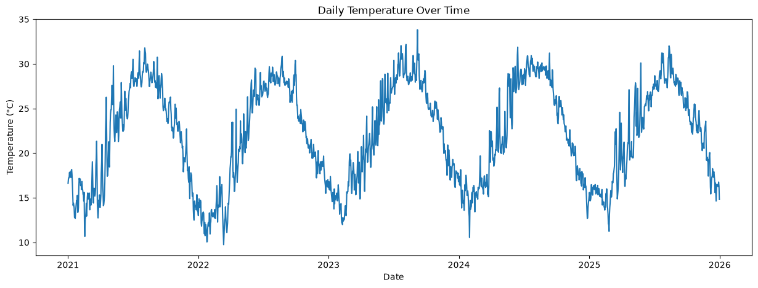
Q2
How does temperature move through the year?
THE INSIGHT
A clear annual cycle repeats every year — hot summers, mild winters, same shape 2021–2025.
No single-day spikes look like sensor errors; swings stay within a believable seasonal envelope.
Alexandria Weather Time-Series Analysis
6

Slide 7
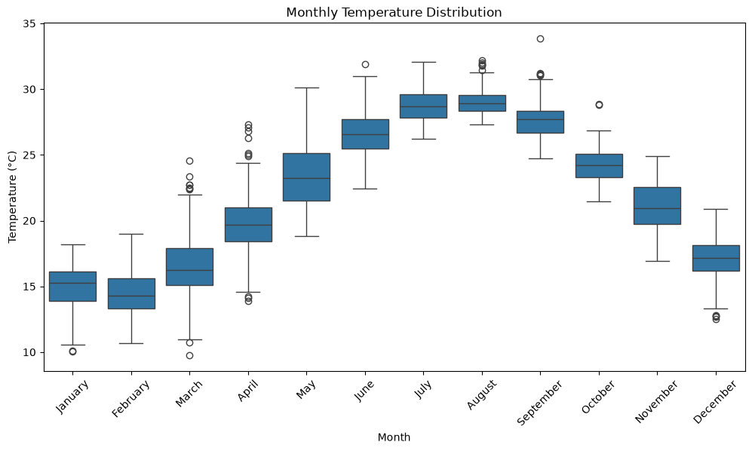
Q3
Which months run hottest — and how consistent are they?
THE INSIGHT
July and August run hottest and most consistent; January is coolest.
Spring and autumn show wider spread — more day-to-day variability than peak summer or winter.
The clean month-to-month step pattern is exactly what a healthy seasonal series looks like.
Alexandria Weather Time-Series Analysis
7

Slide 8
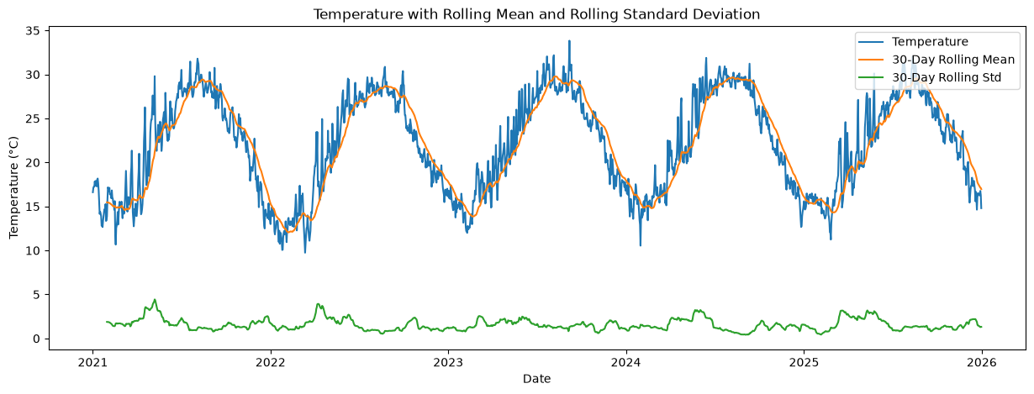
Q4
Is there a long-term trend, or just seasonal swing?
THE INSIGHT
The 30-day rolling mean just retraces the seasonal cycle — no drift toward a hotter or cooler baseline.
Rolling std stays moderate and stable, with mild spikes during spring/autumn swings.
Takeaway: seasonality, not long-term climate trend, drives this 5-year window.
Alexandria Weather Time-Series Analysis
8

Slide 9
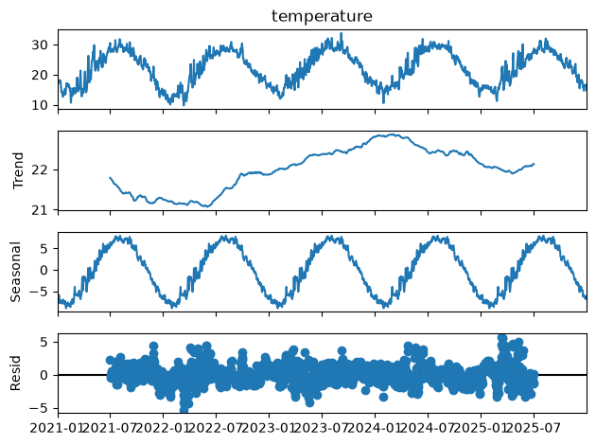
Q5
What's actually driving the pattern — trend, season, or noise?
THE INSIGHT
Decomposition splits the series into a strong seasonal cycle, a near-flat trend, and residual noise around zero.
Seasonality dominates — most of the raw plot's 'volatility' is just the predictable annual cycle.
Sets up the stationarity test next.
Alexandria Weather Time-Series Analysis
9

Slide 10
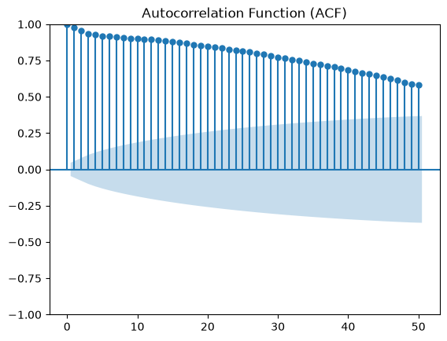
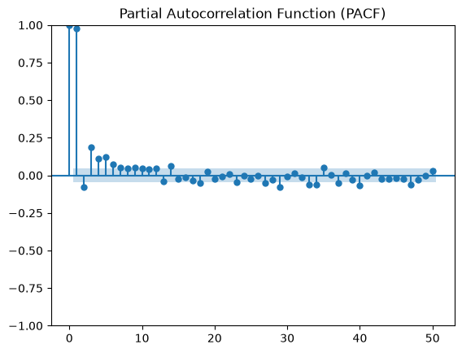
Q6
Is the temperature series stationary?
THE INSIGHT
ACF decays slowly (seasonal signature); PACF spikes at lag 1, then fades fast.
ADF test: statistic -2.258, p = 0.186 — fails to reject the unit-root null. Non-stationary.
Implication: seasonal differencing (or SARIMA) is needed before ARIMA-style forecasting.
Alexandria Weather Time-Series Analysis
10

Slide 11
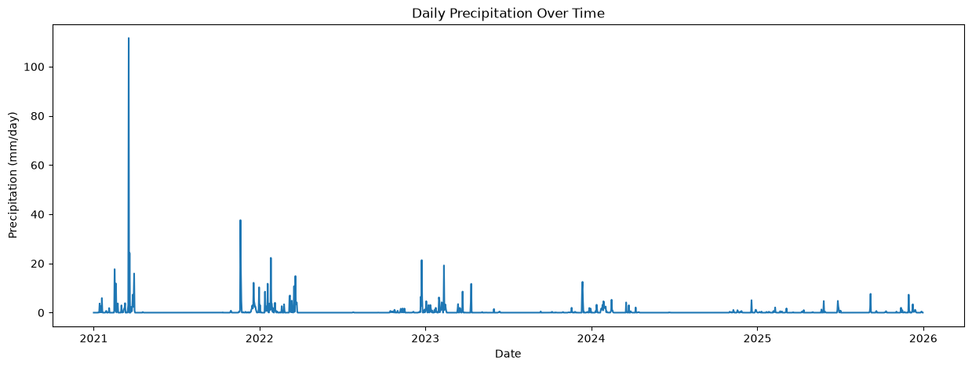
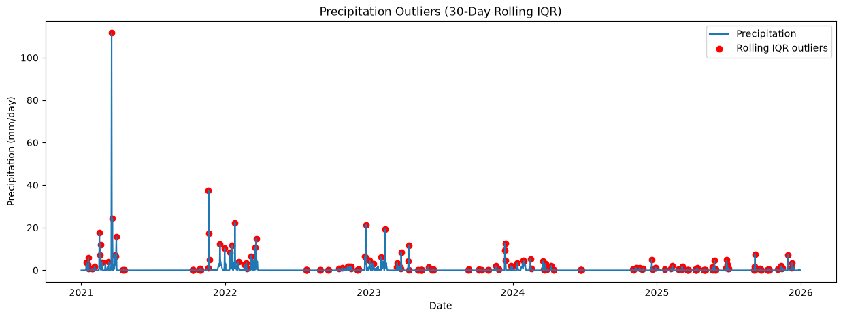
Q7
When does it rain — and are the spikes real?
THE INSIGHT
Rain concentrates in winter (Nov–Mar); the rest of the year is largely dry — Mediterranean climate.
Global IQR flags 372 'outliers' — all legitimate heavy-rain days, no negative values anywhere.
A 30-day rolling IQR (shown here) isolates the truly extreme rain days for their local season.
Alexandria Weather Time-Series Analysis
11

Slide 12
KEY TAKEAWAYS
A clean, seasonal series —
ready for the next step
Zero gaps, duplicates, or missing values across 1,826 daily records.
Temperature is seasonal and non-stationary (ADF p = 0.186) — needs seasonal differencing before ARIMA.
Precipitation is rare, skewed, winter-heavy; 'outliers' are real rain events, not errors.
Variables behave as physically expected — temperature readings move together; rainfall is independent.

